Slide 1

Modified Data Structure of Aho-Corasick
Project ECE-526 Spring 2006
Benfano Soewito, Ed Flanigan and John Pangrazio
Southern Illinois University Carbondale

Slide 2

Introduction
Aho-Corasick Algorithm is used to implement rule checking for Snort type Intrusion Detection Systems.
IDS Sensors are currently placed on hosts and end nodes
Can prevent damage sooner if at core of network

Slide 3
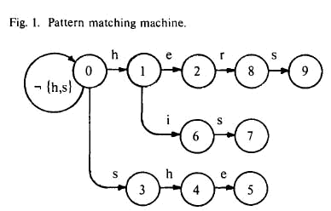
Previous work
A pattern matching machine for the set of keywords {he, she, his, hers}
It has 256 next state pointers which use large amounts memory

Slide 4
Aho-Corasick
Aho-Corasick:
Multi-pattern string matching
Time linear in the size of input
How it works:
Construct the state machine
The state machine starts in the empty root node
Each pattern is added to the state machine
Failure pointers are added from each node to the longest prefix

Slide 5
Methodology
Goal in this project:
Modify the Aho-Corasick algorithm to use less space in memory.
Methodology:
Use a single pointer instead 256 pointers
Use 256 bit bitmap

Slide 6
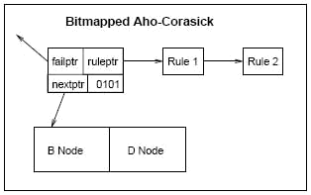
Methodology
Diagram Bitmap Data Structure

Slide 7
Expected result
Use of memory efficient algorithm will allow implementation of Snort rules in a memory of 1.5Mb instead of 60Mb.
Allows the rules to be stored in SRAM on a router/switch instead of independent host
Uses fewer memory lookups and faster search method.

Slide 8
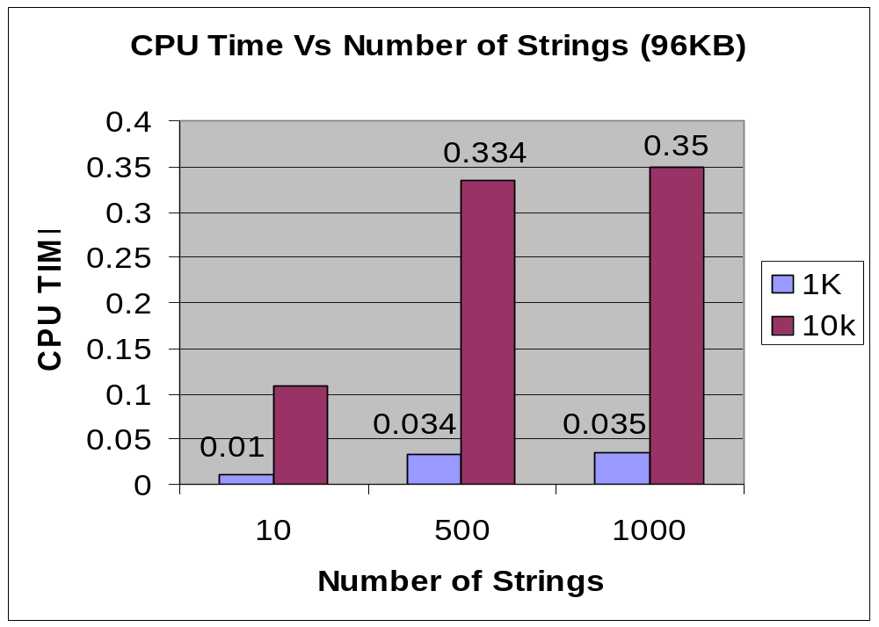
Results: Execution Time
String Matches
# Str | 1K | 10K
10 | 0 | 0
500 | 25 | 47
1000 | 28 | 51

Slide 9
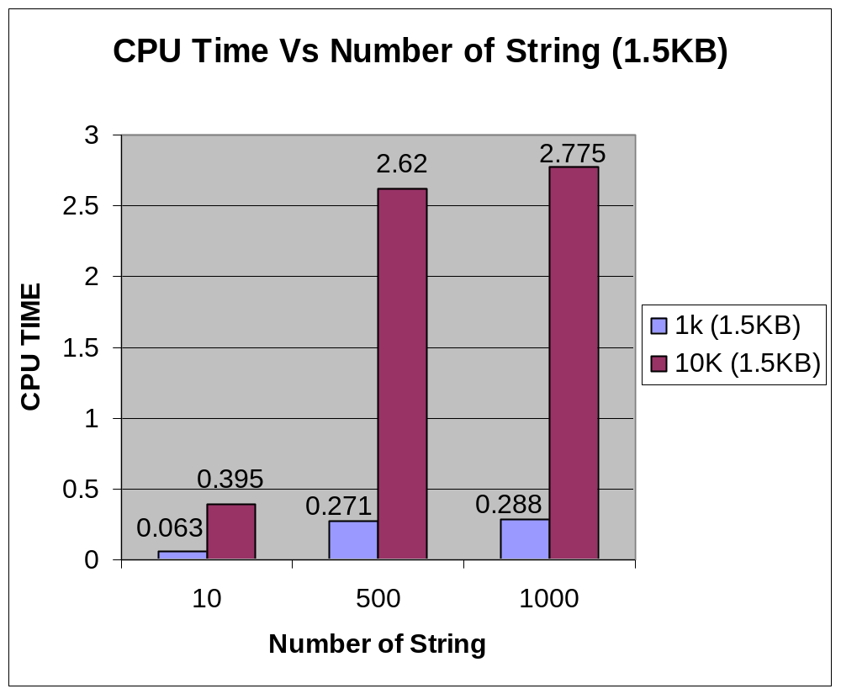
Results: Execution Time
String Matches
# Str | 1K | 10K
10 | 0 | 0
500 | 69 | 85
1000 | 73 | 102

Slide 10
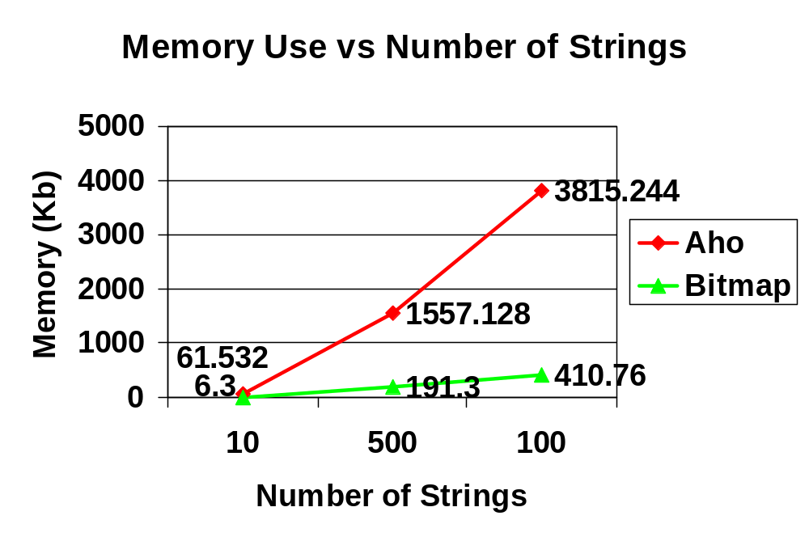
Results: Memory

Slide 11
Results
Statistic of Rules/strings
Strings | Nodes | Pointers Non Bitmap | MEM Aho (KB) | MEM Bitmap (KB)
10 | 175 | 15383 | 61.532 | 6.30
500 | 5314 | 384032 | 1557.128 | 191.30
1000 | 11410 | 942561 | 3815.244 | 410.76
Total | 5433.904 | 608.36
11.2 %

Slide 12
Discussion
Memory use linear with respect to number of strings
Execution time impact dependent on number of string matches
  Minimal Bitmap Computation Overhead

Slide 13
References
A. V. Aho and M. J. Corasick. Efficient string matching: An aid to bibliographic search. Communications of the ACM, 18(6):333–340, 1975.
By G. Varghese, T. Sherwood, N. Tuck and Brad Calder. "Deterministic Memory-Efficient String Matching Algorithms for Intrusion Detection“
R. S. Boyer and J. S. Moore. A fast string searching algorithm

